Slide 1
CS107 Spring 2019, Lecture 2 Bits and Bytes; Integer Representations
reading:
Bryant & O’Hallaron, Ch. 2.2-2.3

Slide 2
CS107 Topic 1: How can a computer represent integer numbers?

Slide 3
Demo: Unexpected Behavior
cp -r /afs/ir/class/cs107/samples/lectures/lect2 .
Notes:
Demo overflow
Change numbers, consistently incorrect!

Slide 4
Plan For Today
Bits and Bytes
Hexadecimal
Integer Representations
Unsigned Integers
Break: Announcements
Signed Integers
Casting and Combining Types

Slide 5
Plan For Today
Bits and Bytes
Hexadecimal
Integer Representations
Unsigned Integers
Break: Announcements
Signed Integers
Casting and Combining Types

Slide 6
0

Slide 7
1

Slide 8
Bits
Computers are built around the idea of two states: “on” and “off”. Transistors represent this in hardware, and bits represent this in software!
Notes:
Bit = Binary-digit

Slide 9
One Bit At A Time
We can combine bits, like with base-10 numbers, to represent more data. 8 bits = 1 byte.
Computer memory is just a large array of bytes! It is byte-addressable; you can’t address (store location of) a bit; only a byte.
Computers still fundamentally operate on bits; we have just gotten more creative about how to represent different data as bits!
Images
Audio
Video
Text
And more…
Notes:
Nibble!

Slide 10
Base 10
5 9 3 4
Digits 0-9 (0 to base-1)

Slide 11
Base 10
5 9 3 4
tens
ones
thousands
hundreds

Slide 12
Base 10
5 9 3 4
tens
ones
thousands
hundreds
= 5*1000 + 9*100 + 3*10 + 4*1

Slide 13
Base 10
5 9 3 4
10³
10²
10¹
10⁰

Slide 14
Base 10
5 9 3 4
10^{X}:
3
2
1
0

Slide 15
Base 2
1 0 1 1
2^{X}:
3
2
1
0
Digits 0-1 (0 to base-1)

Slide 16
Base 2
1 0 1 1
2³
2²
2¹
2⁰

Slide 17
Base 2
1 0 1 1
eights
fours
twos
ones
= 1*8 + 0*4 + 1*2 + 1*1 = 11₁₀

Slide 18
Base 2
Most significant bit (MSB)
Least significant bit (LSB)
1 0 1 1
eights
fours
twos
ones
= 1*8 + 0*4 + 1*2 + 1*1 = 11₁₀

Slide 19
Base 10 to Base 2
Question: What is 6 in base 2?
Strategy:
What is the largest power of 2 ≤ 6?

Slide 20
Base 10 to Base 2
Question: What is 6 in base 2?
Strategy:
What is the largest power of 2 ≤ 6? 2²=4
0
1
_ _ _ _
2³
2²
2¹
2⁰

Slide 21
Base 10 to Base 2
Question: What is 6 in base 2?
Strategy:
What is the largest power of 2 ≤ 6? 2²=4
Now, what is the largest power of 2 ≤ 6 – 2²?
0
1
_ _ _ _
2³
2²
2¹
2⁰

Slide 22
Base 10 to Base 2
Question: What is 6 in base 2?
Strategy:
What is the largest power of 2 ≤ 6? 2²=4
Now, what is the largest power of 2 ≤ 6 – 2²? 2¹=2
0
1
1
_ _ _ _
2³
2²
2¹
2⁰

Slide 23
Base 10 to Base 2
Question: What is 6 in base 2?
Strategy:
What is the largest power of 2 ≤ 6? 2²=4
Now, what is the largest power of 2 ≤ 6 – 2²? 2¹=2
6 – 2² – 2¹ = 0!
0
1
1
_ _ _ _
2³
2²
2¹
2⁰

Slide 24
Base 10 to Base 2
Question: What is 6 in base 2?
Strategy:
What is the largest power of 2 ≤ 6? 2²=4
Now, what is the largest power of 2 ≤ 6 – 2²? 2¹=2
6 – 2² – 2¹ = 0!
0
1
1
0
_ _ _ _
2³
2²
2¹
2⁰

Slide 25
Base 10 to Base 2
Question: What is 6 in base 2?
Strategy:
What is the largest power of 2 ≤ 6? 2²=4
Now, what is the largest power of 2 ≤ 6 – 2²? 2¹=2
6 – 2² – 2¹ = 0!
0
1
1
0
_ _ _ _
2³
2²
2¹
2⁰
= 0*8 + 1*4 + 1*2 + 0*1 = 6

Slide 26
Practice: Base 2 to Base 10
What is the base-2 value 1010 in base-10?
20 (text code: 641180)
101 (text code: 642224)
10 (text code: 642225)
5 (text code: 642226)
Other (text code: 642227)
Respond at pollev.com/nicktroccoli901 or text a code above to 22333.
Notes:
On your own
c

Slide 27

Notes:
What is the base-2 value 1010 in base-10? https://www.polleverywhere.com/multiple_choice_polls/lcWBLVicgZFJTyq5on7dY

Slide 28
Practice: Base 10 to Base 2
What is the base-10 value 14 in base 2?
1111 (text code: 642232)
1110 (text code: 642233)
1010 (text code: 642235)
Other (text code: 642236)
Respond at pollev.com/nicktroccoli901 or text a code above to 22333.
Notes:
On your own
b

Slide 29
Notes:
What is the base-10 value 14 in base-2? https://www.polleverywhere.com/multiple_choice_polls/Wu4t500LBtVGf2cFNmOSc

Slide 30
Byte Values
What is the minimum and maximum base-10 value a single byte (8 bits) can store?

Slide 31
Byte Values
What is the minimum and maximum base-10 value a single byte (8 bits) can store? minimum = 0 maximum = ?

Slide 32
Byte Values
What is the minimum and maximum base-10 value a single byte (8 bits) can store? minimum = 0 maximum = ?
11111111
2^{x}: 7 6 5 4 3 2 1 0

Slide 33
Byte Values
What is the minimum and maximum base-10 value a single byte (8 bits) can store? minimum = 0 maximum = ?
Strategy 1: 1*2⁷ + 1*2⁶ + 1*2⁵ + 1*2⁴ + 1*2³+ 1*2² + 1*2¹ + 1*2⁰ = 255
11111111
2^{x}: 7 6 5 4 3 2 1 0

Slide 34
Byte Values
What is the minimum and maximum base-10 value a single byte (8 bits) can store? minimum = 0 maximum = 255
Strategy 1: 1*2⁷ + 1*2⁶ + 1*2⁵ + 1*2⁴ + 1*2³+ 1*2² + 1*2¹ + 1*2⁰ = 255
Strategy 2: 2⁸ – 1 = 255
11111111
2^{x}: 7 6 5 4 3 2 1 0

Slide 35
Multiplying by Base
1453 x 10 = 14530
1101₂ x 2 = 11010
Key Idea: inserting 0 at the end multiplies by the base!
Notes:
Whiteboard work

Slide 36
Plan For Today
Bits and Bytes
Hexadecimal
Integer Representations
Unsigned Integers
Break: Announcements
Signed Integers
Casting and Combining Types

Slide 37
Hexadecimal
When working with bits, oftentimes we have large numbers with 32 or 64 bits.
Instead, we’ll represent bits in base-16 instead; this is called hexadecimal.
0110 1010 0011

Slide 38
Hexadecimal
When working with bits, oftentimes we have large numbers with 32 or 64 bits.
Instead, we’ll represent bits in base-16 instead; this is called hexadecimal.
0110 1010 0011
0-15
0-15
0-15

Slide 39
Hexadecimal
When working with bits, oftentimes we have large numbers with 32 or 64 bits.
Instead, we’ll represent bits in base-16 instead; this is called hexadecimal.
0-15
0-15
0-15
Each is a base-16 digit!

Slide 40
Hexadecimal
Hexadecimal is base-16, so we need digits for 1-15. How do we do this?
0 1 2 3 4 5 6 7 8 9 a b c d e f
10 11 12 13 14 15

Slide 41
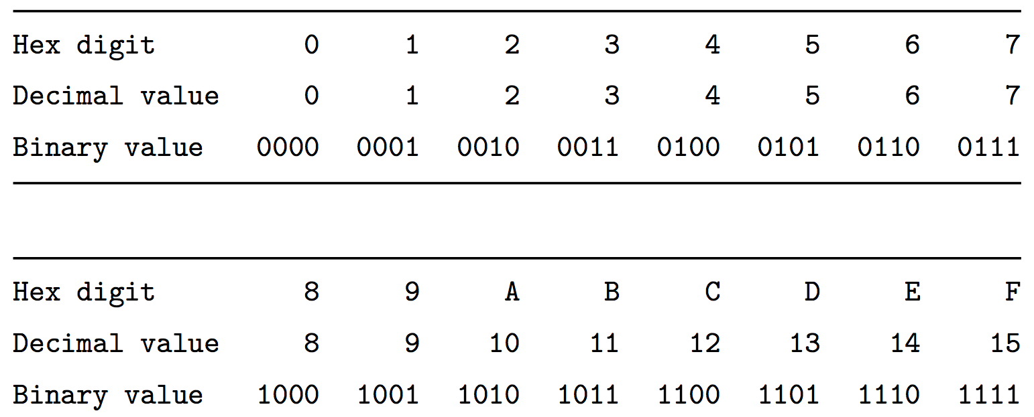
Hexadecimal

Slide 42
Hexadecimal
We distinguish hexadecimal numbers by prefixing them with 0x, and binary numbers with 0b.
E.g. 0xf5 is 0b11110101
0x f 5
1111
0101

Slide 43
Practice: Hexadecimal to Binary
What is 0x173A in binary?
Notes:
To

Slide 44
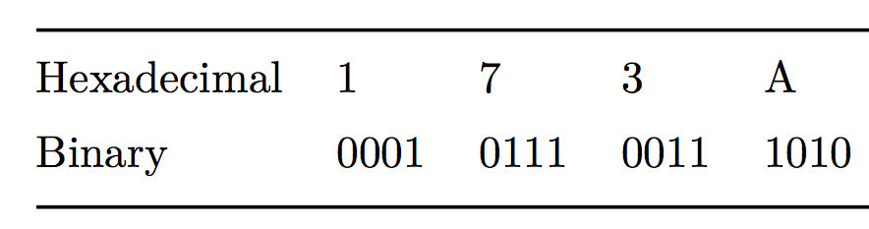
Practice: Hexadecimal to Binary
What is 0x173A in binary?

Slide 45
Practice: Hexadecimal to Binary
What is 0b1111001010110110110011 in hexadecimal? (Hint: start from the right)

Slide 46
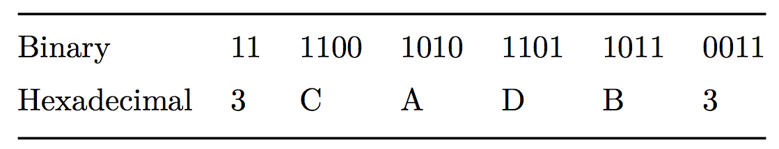
Practice: Hexadecimal to Binary
What is 0b1111001010110110110011 in hexadecimal? (Hint: start from the right)

Slide 47
Plan For Today
Bits and Bytes
Hexadecimal
Integer Representations
Unsigned Integers
Break: Announcements
Signed Integers
Casting and Combining Types

Slide 48
Number Representations
Unsigned Integers: positive and 0 integers. (e.g. 0, 1, 2, … 99999…
Signed Integers: negative, positive and 0 integers. (e.g. …-2, -1, 0, 1,… 9999…)
Floating Point Numbers: real numbers. (e,g. 0.1, -12.2, 1.5x10¹²)

Slide 49
Number Representations
Unsigned Integers: positive and 0 integers. (e.g. 0, 1, 2, … 99999…
Signed Integers: negative, positive and 0 integers. (e.g. …-2, -1, 0, 1,… 9999…)
Floating Point Numbers: real numbers. (e,g. 0.1, -12.2, 1.5x10¹²)
Stay tuned until week 5!

Slide 50
32-Bit and 64-Bit
In the early 2000’s, most computers were 32-bit. This means that pointers in programs were 32 bits.
32-bit pointers could store a memory address from 0 to 2³²-1, for a total of 2³² bytes of addressable memory. This equals 4 Gigabytes, meaning that 32-bit computers could have at most 4GB of memory (RAM)!
Because of this, computers transitioned to 64-bit. This means that pointers in programs were 64 bits.
64-bit pointers could store a memory address from 0 to 2⁶⁴-1, for a total of 2⁶⁴ bytes of addressable memory. This equals 16 Exabytes, meaning that 64-bit computers could have at most 1024*1024*1024 GB of memory (RAM)!
Notes:
Fun fact: mobile devices still transitioning

Slide 51
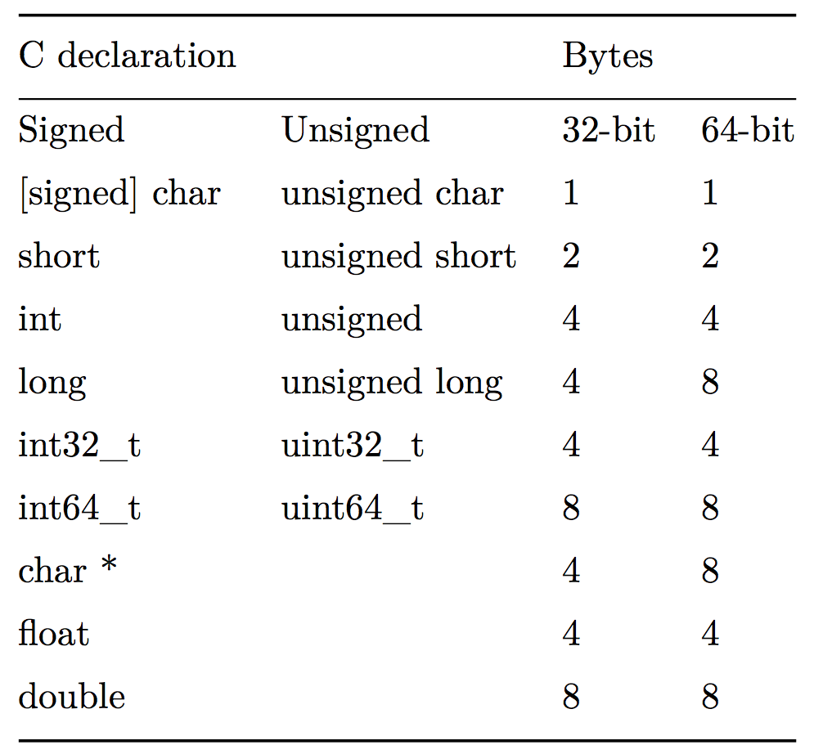
Number Representations

Slide 52
Number Representations
Myth
Notes:
C standard only guarantees int32_t and int64_t!

Slide 53
Plan For Today
Bits and Bytes
Hexadecimal
Integer Representations
Unsigned Integers
Break: Announcements
Signed Integers
Casting and Combining Types

Slide 54
Unsigned Integers
An unsigned integer is 0 or a positive integer (no negatives).
We have already discussed converting between decimal and binary, which is a nice 1:1 relationship. Examples:
0b0001 = 1
0b0101 = 5
0b1011 = 11
0b1111 = 15
The range of an unsigned number is 0 → 2^{w} - 1, where w is the number of bits. E.g. a 32-bit integer can represent 0 to 2³² – 1 (4,294,967,295).

Slide 55
Unsigned Integers

Slide 56
Plan For Today
Bits and Bytes
Hexadecimal
Integer Representations
Unsigned Integers
Break: Announcements
Signed Integers
Casting and Combining Types

Slide 57
Announcements
Sign up for Piazza on the Help page if you haven’t already!
Lab signups opened earlier this week, start next week.
Labs posted on the course website at the start of each week
Office Hours started earlier this week
You must fill out signup questions completely when signing up
Please send course staff OAE letters for accommodations!

Slide 58
Let’s Take A Break
To ponder during the break:
A signed integer is a negative, 0, or positive integer. How can we represent both negative and positive numbers in binary?

Slide 59
Plan For Today
Bits and Bytes
Hexadecimal
Integer Representations
Unsigned Integers
Break: Announcements
Signed Integers
Casting and Combining Types

Slide 60
Signed Integers
A signed integer is a negative integer, 0, or a positive integer.
Problem: How can we represent negative and positive numbers in binary?
Notes:
T-P-S

Slide 61
Signed Integers
A signed integer is a negative integer, 0, or a positive integer.
Problem: How can we represent negative and positive numbers in binary?
Idea: let’s reserve the most significant bit to store the sign.

Slide 62
Sign Magnitude Representation
0110
positive
6
1011
negative
3

Slide 63
Sign Magnitude Representation
0000
positive
0
🤯
1000
negative
0

Slide 64
Sign Magnitude Representation
1 000 = -0
1 001 = -1
1 010 = -2
1 011 = -3
1 100 = -4
1 101 = -5
1 110 = -6
1 111 = -7
0 000 = 0
0 001 = 1
0 010 = 2
0 011 = 3
0 100 = 4
0 101 = 5
0 110 = 6
0 111 = 7
We’ve only represented 15 of our 16 available numbers!

Slide 65
Sign Magnitude Representation
Pro: easy to represent, and easy to convert to/from decimal.
Con: +-0 is not intuitive
Con: we lose a bit that could be used to store more numbers
Con: arithmetic is tricky: we need to find the sign, then maybe subtract (borrow and carry, etc.), then maybe change the sign…this might get ugly!
Can we do better?

Slide 66
A Better Idea
Ideally, binary addition would just work regardless of whether the number is positive or negative.
0101
????
+
0000
Notes:
Extra digits just fall off

Slide 67
A Better Idea
Ideally, binary addition would just work regardless of whether the number is positive or negative.
0101
1011
+
0000

Slide 68
A Better Idea
Ideally, binary addition would just work regardless of whether the number is positive or negative.
0011
????
+
0000

Slide 69
A Better Idea
Ideally, binary addition would just work regardless of whether the number is positive or negative.
0011
1101
+
0000

Slide 70
A Better Idea
Ideally, binary addition would just work regardless of whether the number is positive or negative.
0000
????
+
0000

Slide 71
A Better Idea
Ideally, binary addition would just work regardless of whether the number is positive or negative.
0000
0000
+
0000

Slide 72
A Better Idea
Decimal | Positive | Negative
0 | 0000 | 0000
1 | 0001 | 1111
2 | 0010 | 1110
3 | 0011 | 1101
4 | 0100 | 1100
5 | 0101 | 1011
6 | 0110 | 1010
7 | 0111 | 1001
Decimal | Positive | Negative
8 | 1000 | 1000
9 | 1001 (same as -7!) | NA
10 | 1010 (same as -6!) | NA
11 | 1011 (same as -5!) | NA
12 | 1100 (same as -4!) | NA
13 | 1101 (same as -3!) | NA
14 | 1110 (same as -2!) | NA
15 | 1111 (same as -1!) | NA

Slide 73
There Seems Like a Pattern Here…
0101
0011
0000
1011
1101
0000
+
+
+
0000
0000
0000
The negative number is the positive number inverted, plus one!

Slide 74
There Seems Like a Pattern Here…
A binary number plus its inverse is all 1s.
Add 1 to this to carry over all 1s and get 0!
0101
1111
1010
0001
+
+
1111
0000

Slide 75
Another Trick
To find the negative equivalent of a number, work right-to-left and write down all digits through when you reach a 1. Then, invert the rest of the digits.
100100
??????
+
000000

Slide 76
Another Trick
To find the negative equivalent of a number, work right-to-left and write down all digits through when you reach a 1. Then, invert the rest of the digits.
100100
???100
+
000000

Slide 77
Another Trick
To find the negative equivalent of a number, work right-to-left and write down all digits through when you reach a 1. Then, invert the rest of the digits.
100100
011100
+
000000

Slide 78
Two’s Complement

Slide 79
Two’s Complement
In two’s complement, we represent a positive number as itself, and its negative equivalent as the two’s complement of itself.
The two’s complement of a number is the binary digits inverted, plus 1.
This works to convert from positive to negative, and back from negative to positive!

Slide 80
Two’s Complement
Con: more difficult to represent, and difficult to convert to/from decimal and between positive and negative.
Pro: only 1 representation for 0!
Pro: all bits are used to represent as many numbers as possible
Pro: it turns out that the most significant bit still indicates the sign of a number.
Pro: arithmetic is easy: we just add!

Slide 81
Two’s Complement
Adding two numbers is just…adding! There is no special case needed for negatives. E.g. what is 2 + -5?
0010
2
1011
-5
+
1101
-3

Slide 82
Two’s Complement
Subtracting two numbers is just performing the two’s complement on one of them and then adding. E.g. 4 – 5 = -1.
0100
0100
4
4
0101
1011
5
-5
-
+
1111
-1

Slide 83
Two’s Complement
While you don’t need to worry about multiplication, it turns out that with two’s complement, multiplying two numbers is just multiplying, and discarding overflow digits! E.g. -2 x -3 = 6.
1110 (-2)
x1101 (-3)
1110
0000
1110
+1110
10110110 (6)

Slide 84
Practice: Two’s Complement
What are the negative or positive equivalents of the numbers below?
-4 (1100)
7 (0111)
3 (0011)
-8 (1000)
Notes:
Own: then board: 0100
1001
1101
1000

Slide 85
Practice: Two’s Complement
What are the negative or positive equivalents of the numbers below?
-4 (1100)
7 (0111)
3 (0011)
-8 (1000)
Notes:
0100
1001
1101
1000

Slide 86
Plan For Today
Bits and Bytes
Hexadecimal
Integer Representations
Unsigned Integers
Break: Announcements
Signed Integers
Casting and Combining Types

Slide 87
Overflow and Underflow
If you exceed the maximum value of your bit representation, you wrap around or overflow back to the smallest bit representation.
0b1111 + 0b1 = 0b0000
If you go below the minimum value of your bit representation, you wrap around or underflow back to the largest bit representation.
0b0000 - 0b1 = 0b1111
Notes:
Technically overflowing with signed integers in C is undefined. But it is predictable

Slide 88
Min and Max Integer Values
Type | Width (bytes) | Width (bits) | Min in hex (name) | Max in hex (name)
char | 1 | 8 | 80 (CHAR_MIN) | 7F (CHAR_MAX)
unsigned char | 1 | 8 | 0 | FF (UCHAR_MAX)
short | 2 | 16 | 8000 (SHRT_MIN) | 7FFF (SHRT_MAX)
unsigned short | 2 | 16 | 0 | FFFF (USHRT_MAX)
int | 4 | 32 | 80000000 (INT_MIN) | 7FFFFFFF (INT_MAX)
unsigned int | 4 | 32 | 0 | FFFFFFFF (UINT_MAX)
long | 8 | 64 | 8000000000000000 (LONG_MIN) | 7FFFFFFFFFFFFFFF (LONG_MAX)
unsigned long | 8 | 64 | 0 | FFFFFFFFFFFFFFFF (ULONG_MAX)

Slide 89
Overflow and Underflow
+1
111…111
000…000
+1
111…110
000…001
111…101
000…010
111…100
000…011
…
…
100…010
011…101
100…001
011…110
100…000
011…111
+1

Slide 90
Overflow
At which points can overflow occur for signed and unsigned int? (assume binary values shown are all 32 bits)
Signed and unsigned can both overflow at points X and Y
Signed can overflow only at X, unsigned only at Y
Signed can overflow only at Y, unsigned only at X
Signed can overflow at X and Y, unsigned only at X
Other
111…111
000…000
111…110
000…001
111…101
000…010
111…100
X
000…011
…
…
Y
100…010
011…101
100…001
011…110
100…000
011…111
Notes:
Think-Pair-Share
C
DISCONTINUITY = overflow

Slide 91
Unsigned Integers
≈+4billion
0
111…111
000…000
111…110
000…001
111…101
000…010
111…100
Discontinuity means overflow possible here
000…011
More increasing positive numbers
…
Increasing positive numbers
…
100…010
011…101
100…001
011…110
100…000
011…111

Slide 92
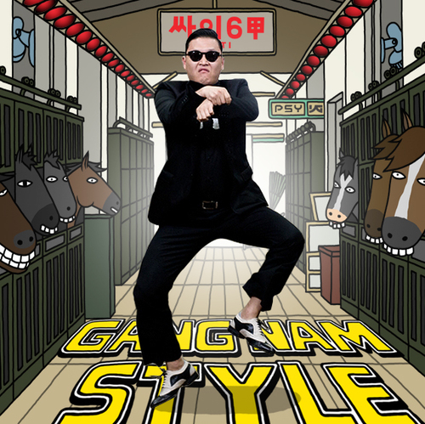
Signed Numbers
-1
0
+1
111…111
000…000
111…110
000…001
111…101
000…010
111…100
000…011
Negative numbers becoming less negative
(i.e. increasing)
Increasing positive numbers
…
…
Discontinuity means overflow possible here
100…010
011…101
100…001
011…110
100…000
011…111
≈+2billion
≈-2billion

Slide 93
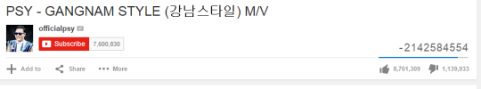
Overflow In Practice: PSY
YouTube: “We never thought a video would be watched in numbers greater than a 32-bit integer (=2,147,483,647 views), but that was before we met PSY. "Gangnam Style" has been viewed so many times we had to upgrade to a 64-bit integer (9,223,372,036,854,775,808)!”

Slide 94
Overflow In Practice: Timestamps
Many systems store timestamps as the number of seconds since Jan. 1, 1970 in a signed 32-bit integer.
Problem: the latest timestamp that can be represented this way is 3:14:07 UTC on Jan. 13 2038!

Slide 95
Underflow In Practice: Gandhi
In the game “Civilization”, each civilization leader had an “aggression” rating. Gandhi was meant to be peaceful, and had a score of 1.
If you adopted “democracy”, all players’ aggression reduced by 2. Gandhi’s went from 1 to 255!
Gandhi then became a big fan of nuclear weapons.
https://kotaku.com/why-gandhi-is-such-an-asshole-in-civilization-1653818245

Slide 96
Recap
Bits and Bytes
Hexadecimal
Integer Representations
Unsigned Integers
Break: Announcements
Signed Integers
Casting and Combining Types
Next time: How can we manipulate individual bits and bytes?

Slide 97
Extra Slides

Slide 98
printf and Integers
There are 3 placeholders for 32-bit integers that we can use:
%d: signed 32-bit int
%u: unsigned 32-bit int
%x: hex 32-bit int
As long as the value is a 32-bit type, printf will treat it according to the placeholder!

Slide 99
Casting
What happens at the byte level when we cast between variable types? The bytes remain the same! This means they may be interpreted differently depending on the type.
int v = -12345;
unsigned int uv = v;
printf("v = %d, uv = %u\n", v, uv);
This prints out: "v = -12345, uv = 4294954951". Why?

Slide 100
Casting
What happens at the byte level when we cast between variable types? The bytes remain the same! This means they may be interpreted differently depending on the type.
int v = -12345;
unsigned int uv = v;
printf("v = %d, uv = %u\n", v, uv);
The bit representation for -12345 is 0b11000000111001.
If we treat this binary representation as a positive number, it’s huge!

Slide 101
Casting
Notes:
SECURITY CONCERNS! Left side means different things

Slide 102
Comparisons Between Different Types
Be careful when comparing signed and unsigned integers. C will implicitly cast the signed argument to unsigned, and then performs the operation assuming both numbers are non-negative.
Expression | Type | Evaluation | Correct?
0 == 0U
-1 < 0
-1 < 0U
2147483647 > -2147483647 - 1
2147483647U > -2147483647 - 1
2147483647 > (int)2147483648U
-1 > -2
(unsigned)-1 > -2
Notes:
ONLY CASTS FOR DIFFERENT TYPES

Slide 103
Comparisons Between Different Types
Be careful when comparing signed and unsigned integers. C will implicitly cast the signed argument to unsigned, and then performs the operation assuming both numbers are non-negative.
Expression | Type | Evaluation | Correct?
0 == 0U | Unsigned | 1 | yes
-1 < 0 | Signed | 1 | yes
-1 < 0U | Unsigned | 0 | No!
2147483647 > -2147483647 - 1 | Signed | 1 | yes
2147483647U > -2147483647 - 1 | Unsigned | 0 | No!
2147483647 > (int)2147483648U | Signed | 1 | No!
-1 > -2 | Signed | 1 | yes
(unsigned)-1 > -2 | Unsigned | 1 | yes

Slide 104
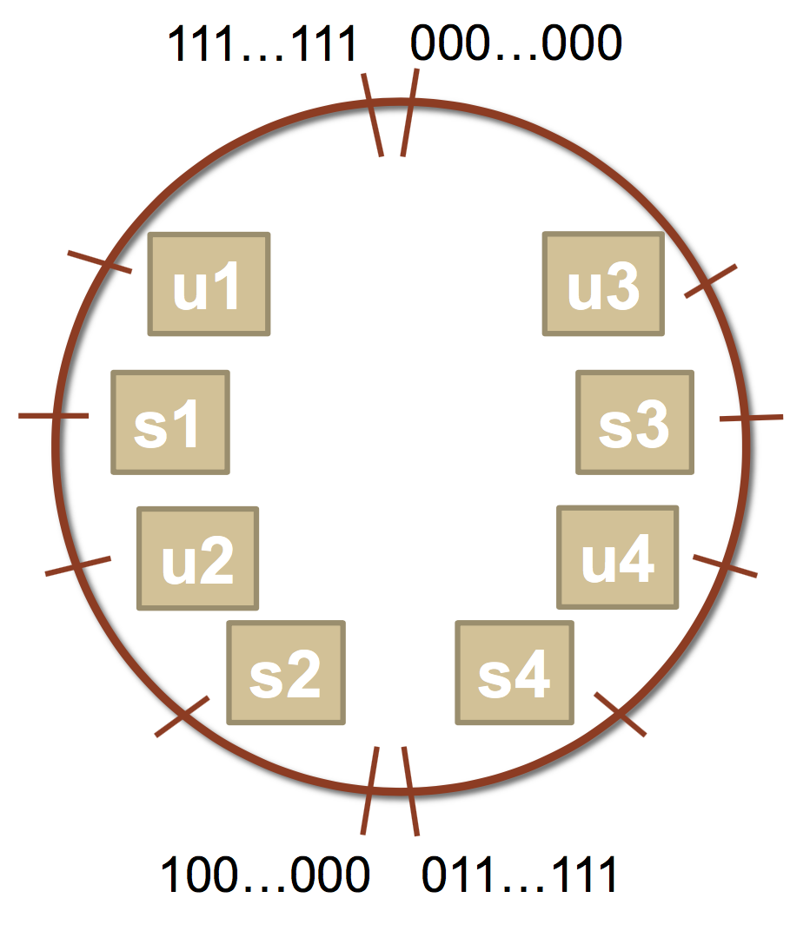
Comparisons Between Different Types
Which many of the following statements are true? (assume that
variables are set to values that place them in the spots shown)
s3 > u3
u2 > u4
s2 > s4
s1 > s2
u1 > u2
s1 > u3
Notes:
**True
True
False
True
True
**true

Slide 105
Comparisons Between Different Types
Which many of the following statements are true? (assume that
variables are set to values that place them in the spots shown)
s3 > u3
u2 > u4
s2 > s4
s1 > s2
u1 > u2
s1 > u3

Slide 106
Comparisons Between Different Types
Which many of the following statements are true? (assume that
variables are set to values that place them in the spots shown)
s3 > u3 - true
u2 > u4 - true
s2 > s4 - false
s1 > s2 - true
u1 > u2 - true
s1 > u3 - true

Slide 107
Expanding Bit Representations
Sometimes, we want to convert between two integers of different sizes (e.g. short to int, or int to long).
We might not be able to convert from a bigger data type to a smaller data type, but we do want to always be able to convert from a smaller data type to a bigger data type.
For unsigned values, we can add leading zeros to the representation (“zero extension”)
For signed values, we can repeat the sign of the value for new digits (“sign extension”
Note: when doing <, >, <=, >= comparison between different size types, it will promote to the larger type.

Slide 108
Expanding Bit Representation
unsigned short s = 4;
// short is a 16-bit format, so s = 0000 0000 0000 0100b
unsigned int i = s;
// conversion to 32-bit int, so i = 0000 0000 0000 0000 0000 0000 0000 0100b

Slide 109
Expanding Bit Representation
short s = 4;
// short is a 16-bit format, so s = 0000 0000 0000 0100b
int i = s;
// conversion to 32-bit int, so i = 0000 0000 0000 0000 0000 0000 0000 0100b
— or —
short s = -4;
// short is a 16-bit format, so s = 1111 1111 1111 1100b
int i = s;
// conversion to 32-bit int, so i = 1111 1111 1111 1111 1111 1111 1111 1100b

Slide 110
Truncating Bit Representation
If we want to reduce the bit size of a number, C truncates the representation and discards the more significant bits.
What happens here? Let's look at the bits in x (a 32-bit int), 53191:
0000 0000 0000 0000 1100 1111 1100 0111
When we cast x to a short, it only has 16-bits, and C truncates the number:
1100 1111 1100 0111
This is -12345! And when we cast sx back an int, we sign-extend the number.
1111 1111 1111 1111 1100 1111 1100 0111 // still -12345
int x = 53191;
short sx = x;
int y = sx;

Slide 111
Truncating Bit Representation
If we want to reduce the bit size of a number, C truncates the representation and discards the more significant bits.
What happens here? Let's look at the bits in x (a 32-bit int), -3:
1111 1111 1111 1111 1111 1111 1111 1101
When we cast x to a short, it only has 16-bits, and C truncates the number:
1111 1111 1111 1101
This is -3! If the number does fit, it will convert fine. y looks like this:
1111 1111 1111 1111 1111 1111 1111 1101 // still -3
int x = -3;
short sx = x;
int y = sx;

Slide 112
Truncating Bit Representation
If we want to reduce the bit size of a number, C truncates the representation and discards the more significant bits.
What happens here? Let's look at the bits in x (a 32-bit unsigned int), 128000:
0000 0000 0000 0001 1111 0100 0000 0000
When we cast x to a short, it only has 16-bits, and C truncates the number:
1111 0100 0000 0000
This is 62464! Unsigned numbers can lose info too. Here is what y looks like:
0000 0000 0000 0000 1111 0100 0000 0000 // still 62464
unsigned int x = 128000;
unsigned short sx = x;
unsigned int y = sx;

Slide 113
The sizeof Operator
sizeof takes a variable type as a parameter and returns the number of bytes that type uses.
printf("sizeof(char): %d\n", (int) sizeof(char));
printf("sizeof(short): %d\n", (int) sizeof(short));
printf("sizeof(int): %d\n", (int) sizeof(int));
printf("sizeof(unsigned int): %d\n", (int) sizeof(unsigned int));
printf("sizeof(long): %d\n", (int) sizeof(long));
printf("sizeof(long long): %d\n", (int) sizeof(long long));
printf("sizeof(size_t): %d\n", (int) sizeof(size_t));
printf("sizeof(void *): %d\n", (int) sizeof(void *));
$ ./sizeof
sizeof(char): 1
sizeof(short): 2
sizeof(int): 4
sizeof(unsigned int): 4
sizeof(long): 8
sizeof(long long): 8
sizeof(size_t): 8
sizeof(void *): 8
Type | Width in bytes | Width in bits
char | 1 | 8
short | 2 | 16
int | 4 | 32
long | 8 | 64
void * | 8 | 64

